Slide 1

DIVINE GRACE COLLEGE OF ARTS, SCIENCE AND TECHNOLOGY
(DGCAST) — GAROUA | GEOGRAPHY DEPARTMENT
UPPER SIXTH ARTS — ECONOMIC GEOGRAPHY — LESSON 23
Weber's Least-Cost Model
Mr KAMDEM EMMANUEL
Geography Teacher — PLEG
Academic Year 2026 / 2027
Notes:
Good morning, class. Today we study Lesson 23: Weber's Least-Cost Model.

Slide 2
GEOGRAPHY — UPPER SIXTH ARTS
CLASS INFO
Class, Chapter & Duration
Class | Upper Sixth Arts
Chapter | Module 6: Understanding and managing the dynamics of economic activities across the world in general and Cameroon in particular
Duration | 2 periods (2 × 50 minutes)
2026 / 2027
DGCAST GAROUA — GEOGRAPHY DEPARTMENT
Mr KAMDEM E. | 2

Slide 3
GEOGRAPHY — UPPER SIXTH ARTS
IDENTIFICATION
Lesson Identification
Topic | Theories of Industrial Location
Sub-topic | Theories of Industrial Location
Lesson | Lesson 23: Weber's Least-Cost Model
Notions / Concepts | Weber, least-cost location, material index, locational triangle, isodapane, labour, agglomeration.
Syllabus focus | Aim and assumptions; the material index; location factors (transport, labour, agglomeration); applicability and criticisms.
Competence | Learners are able to explain Weber's model and assess it.
2026 / 2027
DGCAST GAROUA — GEOGRAPHY DEPARTMENT
Mr KAMDEM E. | 3

Slide 4
GEOGRAPHY — UPPER SIXTH ARTS
OBJECTIVES
Learning Objectives
By the end of the lesson, the learner should be able to:
State the aim and assumptions of Weber's model.
Explain the material index and the location triangle.
Explain labour and agglomeration and assess the model.
2026 / 2027
DGCAST GAROUA — GEOGRAPHY DEPARTMENT
Mr KAMDEM E. | 4

Slide 5
GEOGRAPHY — UPPER SIXTH ARTS
RECALL
Recall
Transport costs affect location.
Some materials lose weight when processed.
2026 / 2027
DGCAST GAROUA — GEOGRAPHY DEPARTMENT
Mr KAMDEM E. | 5

Slide 6
GEOGRAPHY — UPPER SIXTH ARTS
REAL-LIFE SITUATION
Real-Life Situation
A sugar mill is built next to the cane fields at Mbandjock, while a soft drink factory is built in Douala. A learner asks if there is a rule for choosing the cheapest location.
2026 / 2027
DGCAST GAROUA — GEOGRAPHY DEPARTMENT
Mr KAMDEM E. | 6
Notes:
Read the situation slowly, twice.

Slide 7
GEOGRAPHY — UPPER SIXTH ARTS
REAL-LIFE SITUATION
Situation — Question 1
What is the problem in the situation?
2026 / 2027
DGCAST GAROUA — GEOGRAPHY DEPARTMENT
Mr KAMDEM E. | 7

Slide 8
GEOGRAPHY — UPPER SIXTH ARTS
REAL-LIFE SITUATION
Answer
Industries choose different least-cost locations.
2026 / 2027
DGCAST GAROUA — GEOGRAPHY DEPARTMENT
Mr KAMDEM E. | 8

Slide 9
GEOGRAPHY — UPPER SIXTH ARTS
REAL-LIFE SITUATION
Situation — Question 2
Why is the sugar mill near the cane?
2026 / 2027
DGCAST GAROUA — GEOGRAPHY DEPARTMENT
Mr KAMDEM E. | 9

Slide 10
GEOGRAPHY — UPPER SIXTH ARTS
REAL-LIFE SITUATION
Answer
Cane is heavy and loses weight when processed.
2026 / 2027
DGCAST GAROUA — GEOGRAPHY DEPARTMENT
Mr KAMDEM E. | 10

Slide 11
GEOGRAPHY — UPPER SIXTH ARTS
REAL-LIFE SITUATION
Situation — Question 3
Which model explains this?
2026 / 2027
DGCAST GAROUA — GEOGRAPHY DEPARTMENT
Mr KAMDEM E. | 11

Slide 12
GEOGRAPHY — UPPER SIXTH ARTS
REAL-LIFE SITUATION
Possible Answer
Weber's least-cost model.
2026 / 2027
DGCAST GAROUA — GEOGRAPHY DEPARTMENT
Mr KAMDEM E. | 12

Slide 13
GEOGRAPHY — UPPER SIXTH ARTS
JUSTIFICATION
Justification of the Lesson
This lesson helps us to understand a classic theory of industrial location.
2026 / 2027
DGCAST GAROUA — GEOGRAPHY DEPARTMENT
Mr KAMDEM E. | 13

Slide 14

GEOGRAPHY — UPPER SIXTH ARTS
I. ASSUMPTIONS
Activity 1
A flat plain.
2026 / 2027
DGCAST GAROUA — GEOGRAPHY DEPARTMENT
Mr KAMDEM E. | 14
Notes:
Without the projector: list assumptions.

Slide 15
GEOGRAPHY — UPPER SIXTH ARTS
I. ASSUMPTIONS
Activity 1: Question
Give two assumptions of Weber's model.
2026 / 2027
DGCAST GAROUA — GEOGRAPHY DEPARTMENT
Mr KAMDEM E. | 15

Slide 16
GEOGRAPHY — UPPER SIXTH ARTS
I. ASSUMPTIONS
Answer
Uniform plain; transport cost depends on weight and distance (also fixed markets and materials).
2026 / 2027
DGCAST GAROUA — GEOGRAPHY DEPARTMENT
Mr KAMDEM E. | 16

Slide 17

GEOGRAPHY — UPPER SIXTH ARTS
II. LOCATION TRIANGLE
Activity 2
Weber's location triangle.
2026 / 2027
DGCAST GAROUA — GEOGRAPHY DEPARTMENT
Mr KAMDEM E. | 17
Notes:
Without the projector: draw the triangle.

Slide 18
GEOGRAPHY — UPPER SIXTH ARTS
II. LOCATION TRIANGLE
Activity 2: Question
Where is the least-cost location?
2026 / 2027
DGCAST GAROUA — GEOGRAPHY DEPARTMENT
Mr KAMDEM E. | 18

Slide 19
GEOGRAPHY — UPPER SIXTH ARTS
II. LOCATION TRIANGLE
Answer
Where total transport cost of materials and product is lowest.
2026 / 2027
DGCAST GAROUA — GEOGRAPHY DEPARTMENT
Mr KAMDEM E. | 19

Slide 20
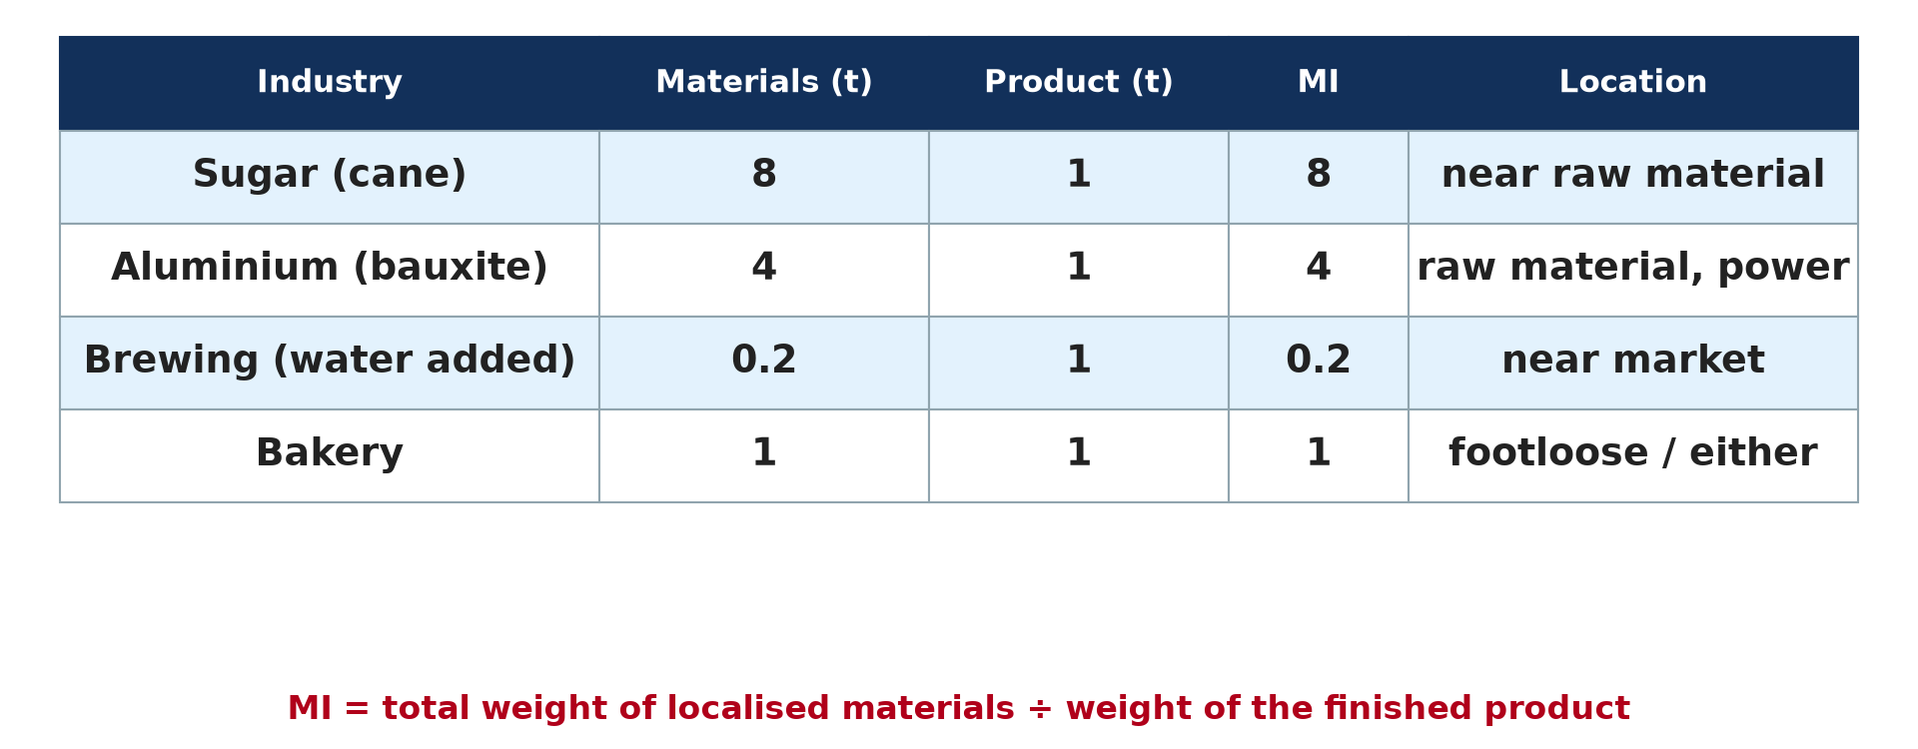
GEOGRAPHY — UPPER SIXTH ARTS
II. MATERIAL INDEX
Activity 3
Material index examples.
2026 / 2027
DGCAST GAROUA — GEOGRAPHY DEPARTMENT
Mr KAMDEM E. | 20
Notes:
Without the projector: calculate MI.

Slide 21
GEOGRAPHY — UPPER SIXTH ARTS
II. MATERIAL INDEX
Activity 3: Question
A sugar mill uses 8 t of cane to make 1 t of sugar. Where should it be?
2026 / 2027
DGCAST GAROUA — GEOGRAPHY DEPARTMENT
Mr KAMDEM E. | 21

Slide 22
GEOGRAPHY — UPPER SIXTH ARTS
II. MATERIAL INDEX
Answer
MI = 8 > 1, so near the cane fields.
2026 / 2027
DGCAST GAROUA — GEOGRAPHY DEPARTMENT
Mr KAMDEM E. | 22

Slide 23
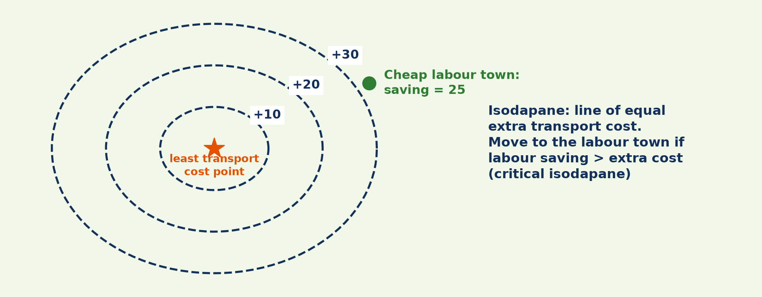
GEOGRAPHY — UPPER SIXTH ARTS
III. LABOUR
Activity 4
Isodapanes and cheap labour.
2026 / 2027
DGCAST GAROUA — GEOGRAPHY DEPARTMENT
Mr KAMDEM E. | 23
Notes:
Without the projector: explain the critical isodapane.

Slide 24
GEOGRAPHY — UPPER SIXTH ARTS
III. LABOUR
Activity 4: Question
When will a firm move to a cheap-labour town?
2026 / 2027
DGCAST GAROUA — GEOGRAPHY DEPARTMENT
Mr KAMDEM E. | 24

Slide 25
GEOGRAPHY — UPPER SIXTH ARTS
III. LABOUR
Answer
When labour savings are greater than extra transport costs.
2026 / 2027
DGCAST GAROUA — GEOGRAPHY DEPARTMENT
Mr KAMDEM E. | 25

Slide 26
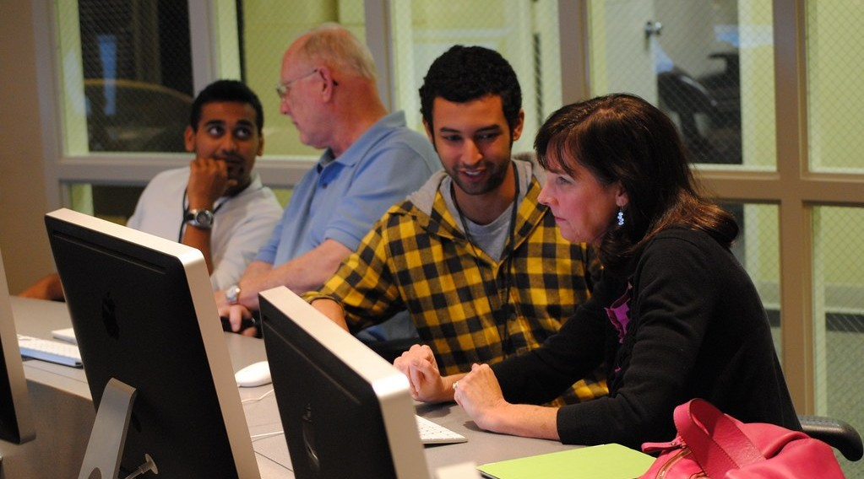
GEOGRAPHY — UPPER SIXTH ARTS
IV. CRITICISMS
Activity 5
Skilled workers in a modern firm.
2026 / 2027
DGCAST GAROUA — GEOGRAPHY DEPARTMENT
Mr KAMDEM E. | 26
Notes:
Without the projector: list criticisms.

Slide 27
GEOGRAPHY — UPPER SIXTH ARTS
IV. CRITICISMS
Activity 5: Question
Give two criticisms of Weber's model.
2026 / 2027
DGCAST GAROUA — GEOGRAPHY DEPARTMENT
Mr KAMDEM E. | 27

Slide 28
GEOGRAPHY — UPPER SIXTH ARTS
IV. CRITICISMS
Answer
Transport costs are less important today; it ignores demand and government.
2026 / 2027
DGCAST GAROUA — GEOGRAPHY DEPARTMENT
Mr KAMDEM E. | 28

Slide 29
GEOGRAPHY — UPPER SIXTH ARTS
BOARD SUMMARY
Weber's Least-Cost Model
Topic: Theories of Industrial Location
Sub-topic: Theories of Industrial Location
Lesson 23: Weber's Least-Cost Model
2026 / 2027
DGCAST GAROUA — GEOGRAPHY DEPARTMENT
Mr KAMDEM E. | 29
Notes:
Learners copy the board summary now. Give them enough time for each slide.

Slide 30
GEOGRAPHY — UPPER SIXTH ARTS
BOARD SUMMARY
I. Definitions
Least-cost location: It is the place where total production and transport costs are lowest.
Material index (MI): It is the weight of localised materials divided by the weight of the product.
Isodapane: It is a line joining places with equal extra transport cost.
2026 / 2027
DGCAST GAROUA — GEOGRAPHY DEPARTMENT
Mr KAMDEM E. | 30

Slide 31
GEOGRAPHY — UPPER SIXTH ARTS
BOARD SUMMARY
II. The Model (1909) (1/2)
A. Aim and assumptions: Weber sought the least-cost location for a factory. He assumed a uniform plain, fixed markets and materials, and transport cost rising with weight and distance.
B. Material index: If MI > 1, the factory locates near raw materials. If MI < 1, it locates near the market.
2026 / 2027
DGCAST GAROUA — GEOGRAPHY DEPARTMENT
Mr KAMDEM E. | 31

Slide 32
GEOGRAPHY — UPPER SIXTH ARTS
BOARD SUMMARY
II. The Model (1909) (2/2)
C. Labour and agglomeration: A firm moves to cheap labour if savings exceed extra transport cost (critical isodapane). Agglomeration savings can also pull firms together.
2026 / 2027
DGCAST GAROUA — GEOGRAPHY DEPARTMENT
Mr KAMDEM E. | 32

Slide 33
GEOGRAPHY — UPPER SIXTH ARTS
BOARD SUMMARY
III. Applicability and Criticisms (1/2)
A. Applicability: It explains heavy industries like sugar, cement and steel. The material index is still useful.
B. Criticisms: Transport costs are lower today and not proportional to distance. It ignores demand, government and human choice.
2026 / 2027
DGCAST GAROUA — GEOGRAPHY DEPARTMENT
Mr KAMDEM E. | 33

Slide 34
GEOGRAPHY — UPPER SIXTH ARTS
BOARD SUMMARY
III. Applicability and Criticisms (2/2)
Copy the triangle and MI rule.
2026 / 2027
DGCAST GAROUA — GEOGRAPHY DEPARTMENT
Mr KAMDEM E. | 34

Slide 35
GEOGRAPHY — UPPER SIXTH ARTS
FORMATIVE EVALUATION
Formative Evaluation 1
What does MI > 1 mean?
2026 / 2027
DGCAST GAROUA — GEOGRAPHY DEPARTMENT
Mr KAMDEM E. | 35

Slide 36
GEOGRAPHY — UPPER SIXTH ARTS
FORMATIVE EVALUATION
Expected Answer
The materials lose weight, so the factory locates near raw materials.
2026 / 2027
DGCAST GAROUA — GEOGRAPHY DEPARTMENT
Mr KAMDEM E. | 36

Slide 37
GEOGRAPHY — UPPER SIXTH ARTS
FORMATIVE EVALUATION
Formative Evaluation 2
Give two criticisms of Weber's model.
2026 / 2027
DGCAST GAROUA — GEOGRAPHY DEPARTMENT
Mr KAMDEM E. | 37

Slide 38
GEOGRAPHY — UPPER SIXTH ARTS
FORMATIVE EVALUATION
Expected Answer
It overstates transport cost; it ignores demand and government.
2026 / 2027
DGCAST GAROUA — GEOGRAPHY DEPARTMENT
Mr KAMDEM E. | 38

Slide 39
GEOGRAPHY — UPPER SIXTH ARTS
REMEDIATION
Remediation
Fill in the blanks:
MI < 1 means locate near the ______.
A line of equal extra transport cost is an ______.
Weber sought the ______-cost location.
2026 / 2027
DGCAST GAROUA — GEOGRAPHY DEPARTMENT
Mr KAMDEM E. | 39
Notes:
Answers: 1. market 2. isodapane 3. least

Slide 40
GEOGRAPHY — UPPER SIXTH ARTS
HOMEWORK
Homework
Calculate the MI of two industries and state their best location.
This prepares Practical Work 3: Material Index and Isodapanes.
2026 / 2027
DGCAST GAROUA — GEOGRAPHY DEPARTMENT
Mr KAMDEM E. | 40
Notes:
This homework prepares the next lesson.

Slide 41
GEOGRAPHY — UPPER SIXTH ARTS
BILINGUAL GAME
Bilingual Game (Jeu Bilingue)
English | Français
Least cost | Le moindre coût
Material index | L'indice matière
Triangle | Le triangle
Weight | Le poids
Isodapane | L'isodapane
Labour cost | Le coût de la main-d'œuvre
2026 / 2027
DGCAST GAROUA — GEOGRAPHY DEPARTMENT
Mr KAMDEM E. | 41
Notes:
Say the English word; learners give the French word, then the reverse.

Slide 42
GEOGRAPHY — UPPER SIXTH ARTS
LOGBOOK
Official Logbook (1/2)
Module / Topic | Theories of Industrial Location
Lesson Title | Lesson 23: Weber's Least-Cost Model
Expected Learning Outcomes | State the aim and assumptions of Weber's model. Explain the material index and the location triangle. Explain labour and agglomeration and assess the model.
Competence | Learners are able to explain Weber's model and assess it.
2026 / 2027
DGCAST GAROUA — GEOGRAPHY DEPARTMENT
Mr KAMDEM E. | 42

Slide 43
GEOGRAPHY — UPPER SIXTH ARTS
LOGBOOK
Official Logbook (2/2)
Matter Taught | I. Definitions: Least-cost location, Material index (MI), Isodapane; II. The Model (1909): Aim and assumptions, Material index, Labour and agglomeration; III. Applicability and Criticisms: Applicability, Criticisms.
Evaluation | Formative evaluation (3 questions) and remediation exercise.
Homework | Calculate the MI of two industries and state their best location.
Enrolment / Present / Absent | ____ / ____ / ____
Achievement | To be completed by the teacher after the lesson.
2026 / 2027
DGCAST GAROUA — GEOGRAPHY DEPARTMENT
Mr KAMDEM E. | 43

Slide 44
GEOGRAPHY — UPPER SIXTH ARTS
TEACHER'S NOTE
Teacher's Note
Timing: Set-up, recall 8 min | Situation 8 min | 5 activities 30 min | Board summary (copying) 30 min | Evaluation, remediation 10 min | Homework, logbook 9 min | Spare 5 min
2026 / 2027
DGCAST GAROUA — GEOGRAPHY DEPARTMENT
Mr KAMDEM E. | 44

Slide 45
GEOGRAPHY — UPPER SIXTH ARTS
REFERENCES
References
National Geography Syllabus, Sixth Forms (Lower & Upper Sixth), MINESEC/IGE/IP-SS, August 2019 — Module 6 (Economic Geography).
Photo, Activity 1: “Blue Wildebeest in the Lowveld” by Martin_Heigan, CC BY-NC-ND 2.0, via Flickr (https://www.flickr.com/photos/97303475@N00/2089079933)
Photo, Activity 5: “Knight-Crane Convergence Lab” by Knight Foundation, CC BY-SA 2.0, via Flickr (https://www.flickr.com/photos/9133668@N08/6242015734)
Diagrams and animations: drawn for this lesson (DGCAST Geography Department).
2026 / 2027
DGCAST GAROUA — GEOGRAPHY DEPARTMENT
Mr KAMDEM E. | 45

